Slide 1


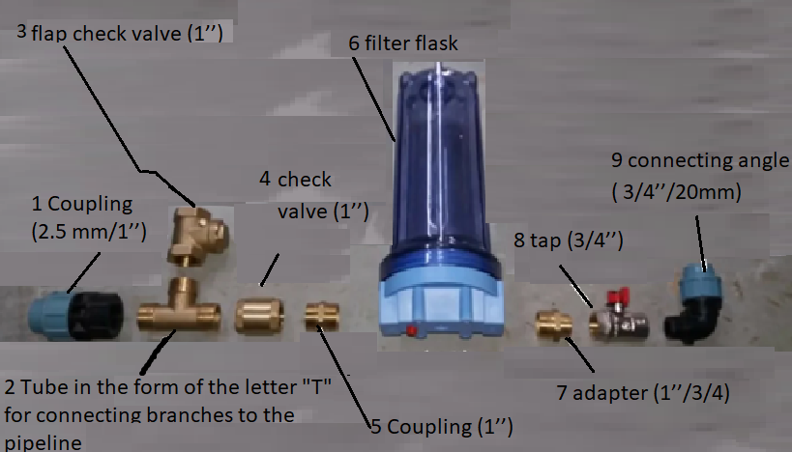


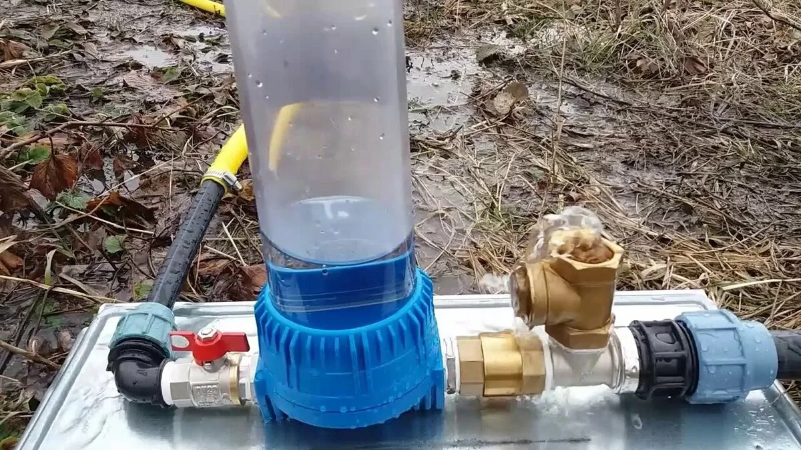
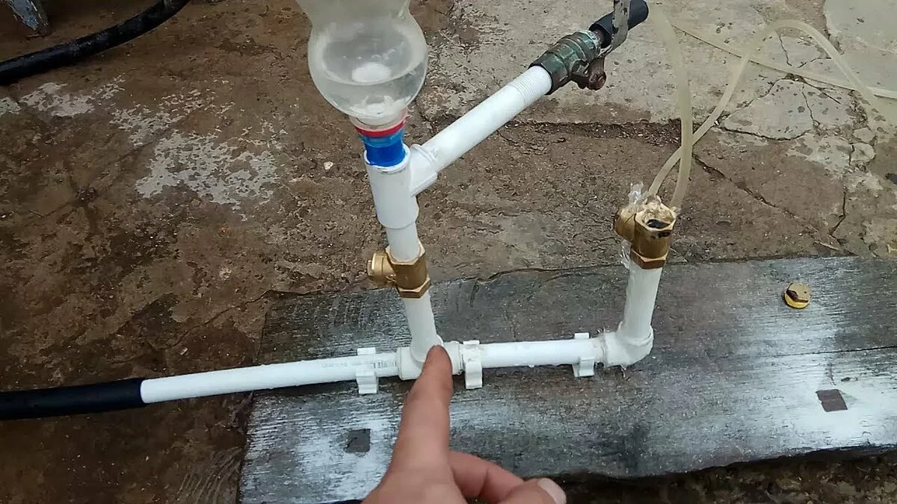
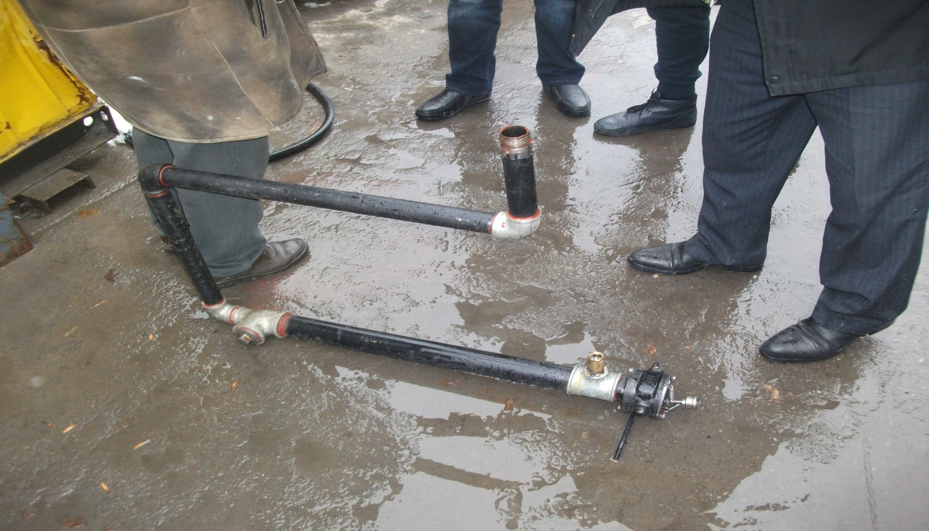

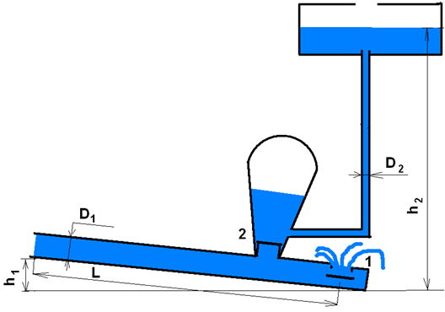






Didar Auyes
M. Auezov South Kazakhstan university
www.icse.eu/irnational-projects/ost
Practical application of the water hammer phenomenon
0
  A SIMPLE HYDROTARAN WITH YOUR OWN HANDS
The aim of the project: Creation of Hydrotaran
Its main area of application is land reclamation and irrigation
The operation of the hydrotaran is based on the use of the phenomenon of water hammer - a short-term sharp increase in pressure when the fluid flow suddenly stops in a rigid pipe
  APPLICATION OF HYDROTARAN
The work of the proposed hydrotaran is as follows:
1. If the valve is closed abruptly, then the water, which has the kinetic energy of motion, will expend its energy on compressing the water and expanding the walls of the pipe.
At the initial moment of time, increased pressure will appear at the end of the pipe at valve 1. Then the zone of increased pressure will propagate to the beginning of the pipe at a speed C.
After a period of time t, the shock will reach the beginning of the pipe, and all the water in the pipe will stop. From this point on, the compressed water at the beginning of the pipe will expand. After all, the beginning of the pipe is open. The pressure will decrease, and a low pressure jump will run to the end of the pipe, to valve 1.
Then these processes will be repeated. Damped oscillations will occur in the pipe. We have considered processes in a pipe with one valve.

