Slide 1


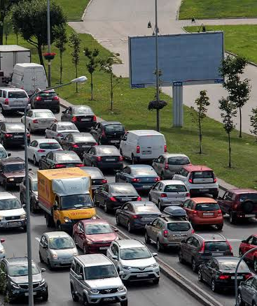
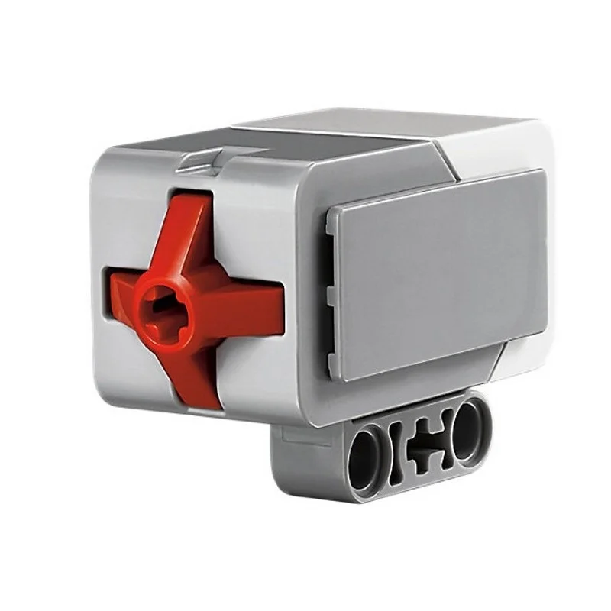
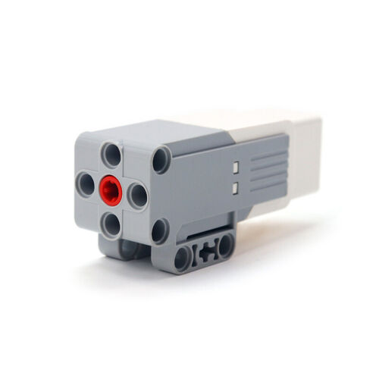
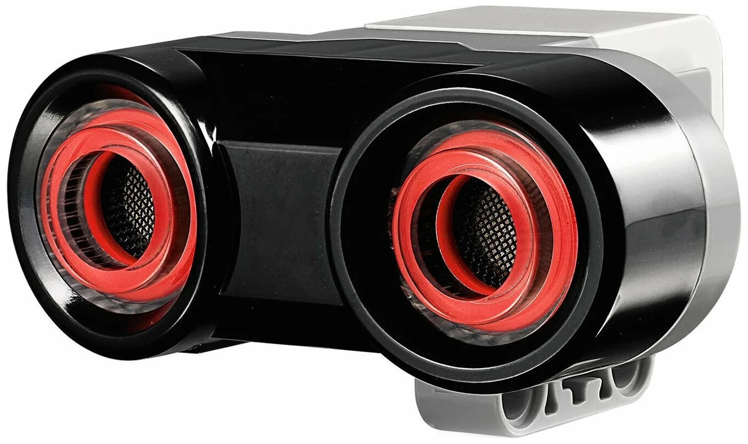
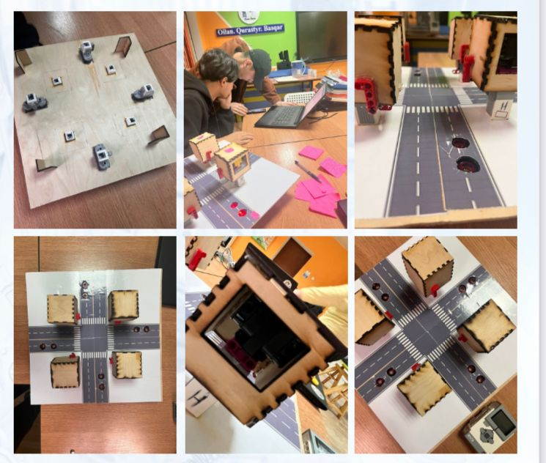






Zhaksylyk Nesibeli
M. Auezov South Kazakhstan university
Smart-traffic light aimed at reducing traffic congestion in the public environment
0
Necessary details for a smart traffic light:
This project consists of :
4 medium motors
4 or 8 ultrasonic transducers
2 touch sensor
8 cables
2 wooden mini boxes
1 microcontroller
The result

